Slide 1

Insights
Week-3 - RDBMS

Slide 2
Agenda
Definitions
Keys
Constraints
Indexes
Example

Slide 3
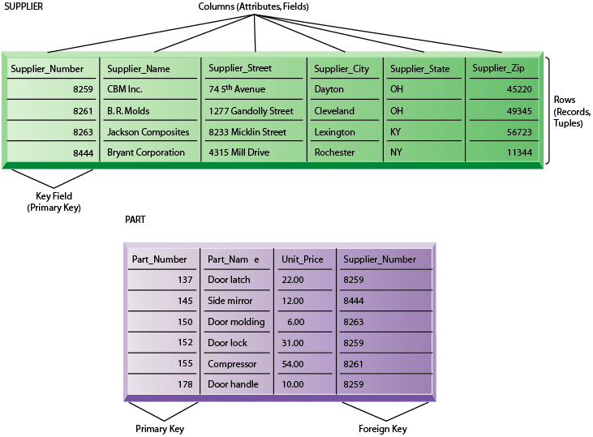
Definitions

Slide 4
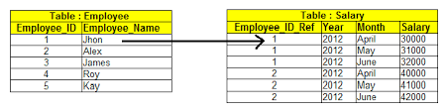
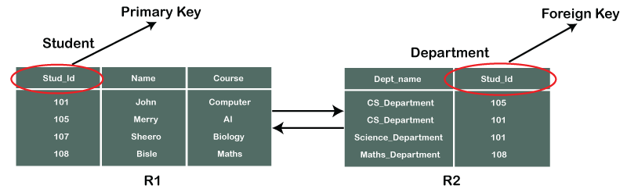
Keys

Slide 5
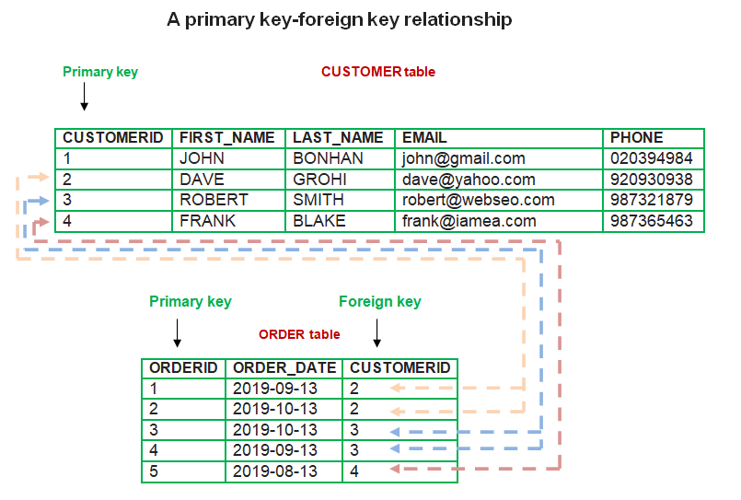
Keys

Slide 6
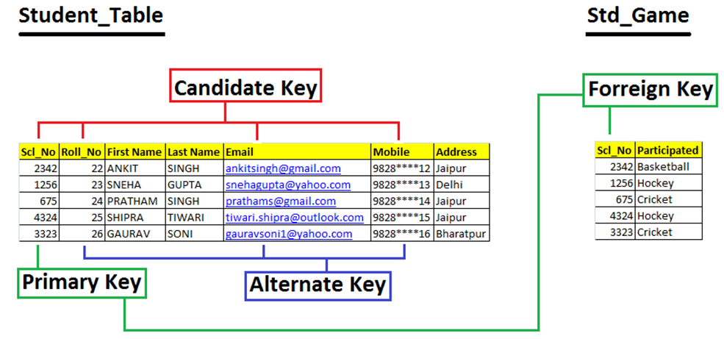
Keys
Notes:
Candidate Keys = Primary key + alternate Keys

Slide 7
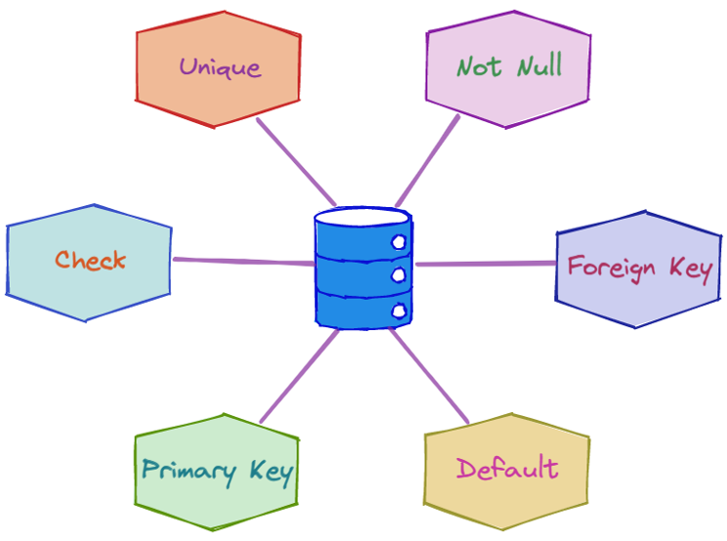
Constraints
Notes:
Check – We can do custom validation

Slide 8
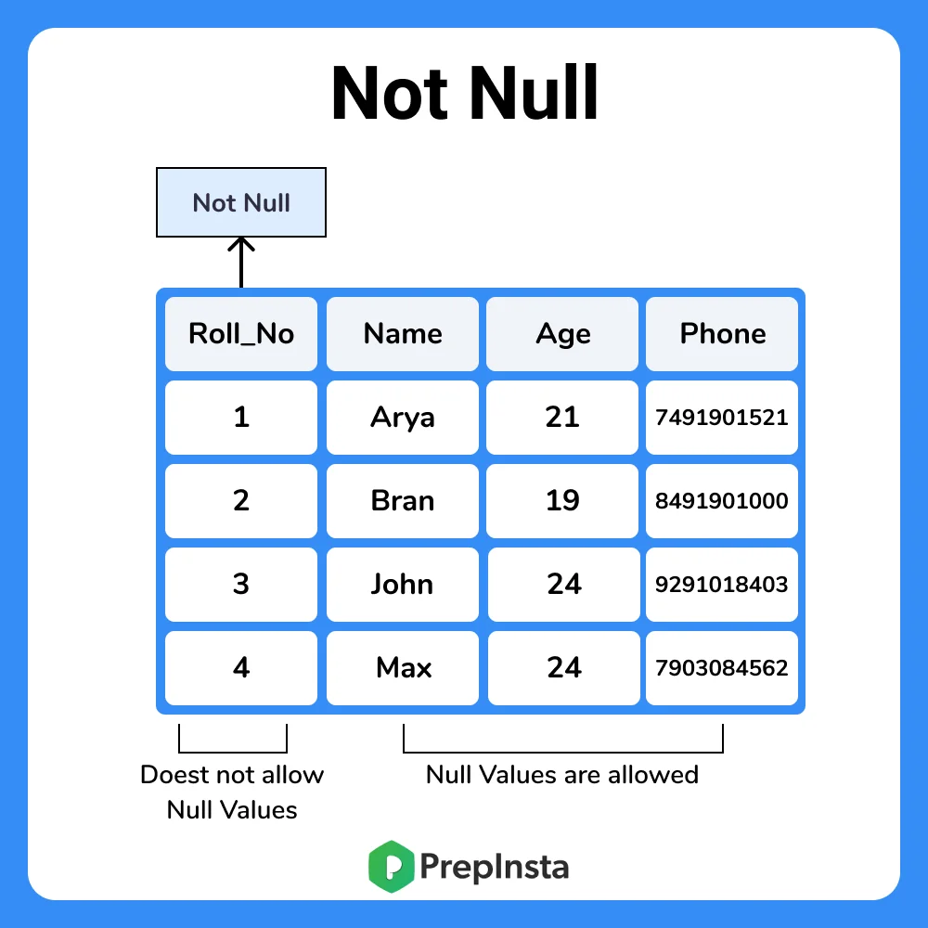
Not NULL
Notes:
Example :
CREATE TABLE Orders ( OrderID int NOT NULL, OrderNumber int NOT NULL, PersonID int, PRIMARY KEY (OrderID));

Slide 9
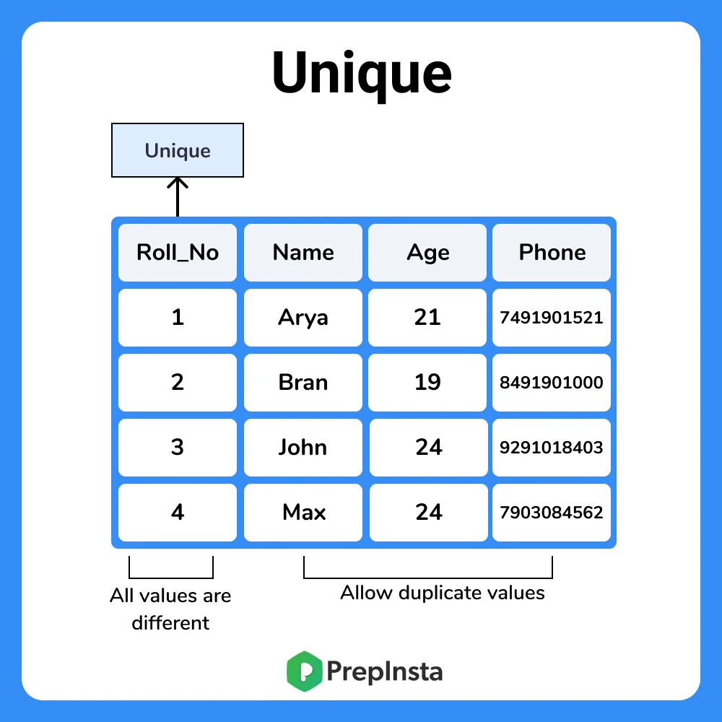
Unique
Notes:
CREATE TABLE Persons ( ID int UNIQUE, LastName varchar(255) NOT NULL, FirstName varchar(255), Age int, );

Slide 10
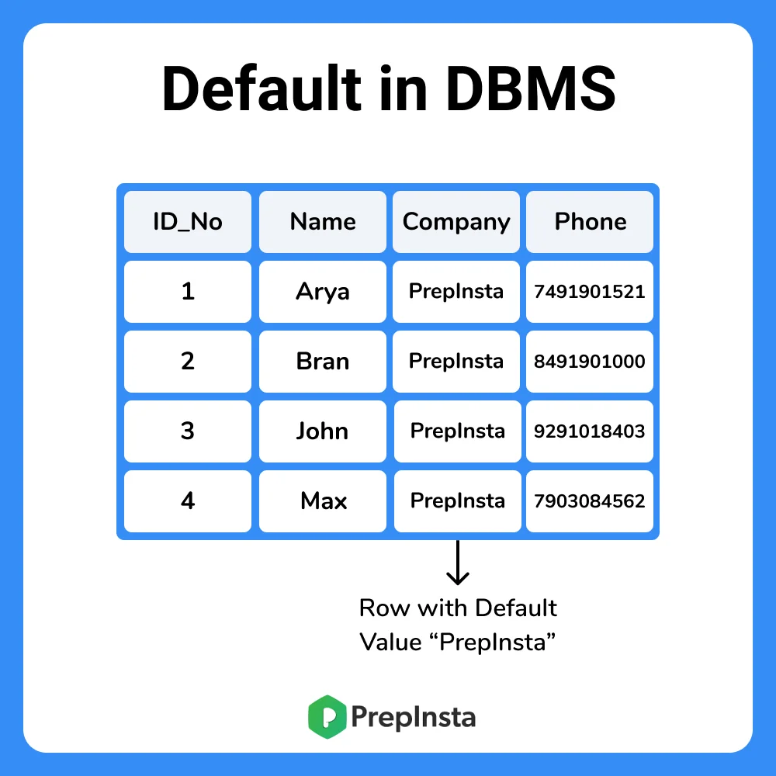
Default
Notes:
CREATE TABLE emp ( ID int NOT NULL, LastName varchar(255) NOT NULL, FirstName varchar(255), Age int, City varchar(255) DEFAULT 'hyderabad' );

Slide 11
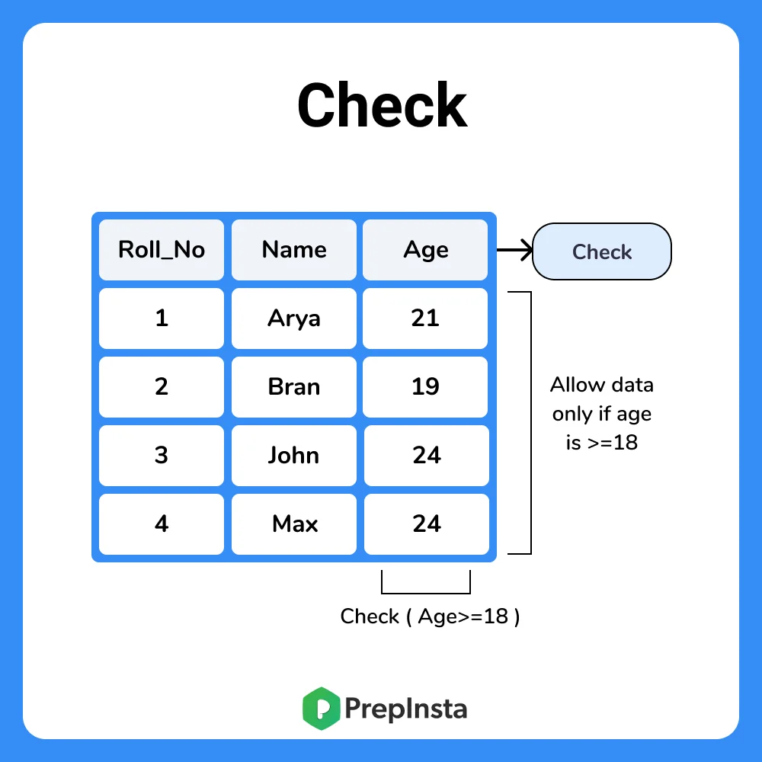
Check
Notes:
CREATE TABLE STUDENT ( ID int , Name varchar(255) , Age int, CHECK (Age>=18) );

Slide 12
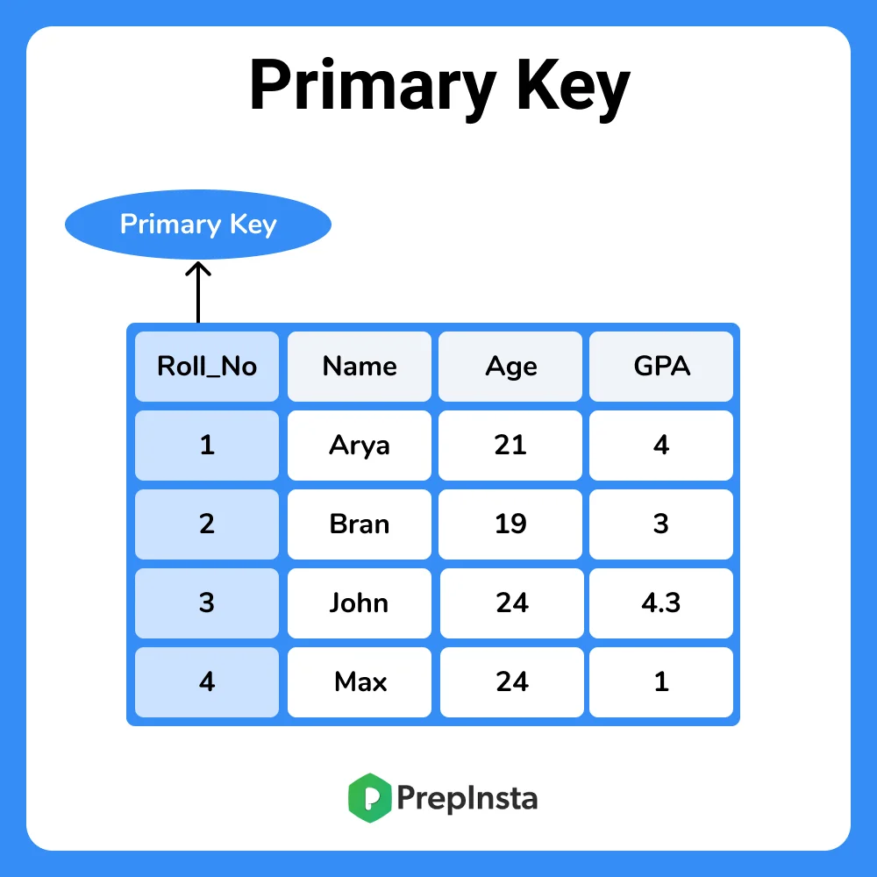
Primary Key
Notes:
CREATE TABLE EMP ( ID INT NAME VARCHAR (20) AGE INT COURSE VARCHAR(10) PRIMARY KEY (ID) );

Slide 13
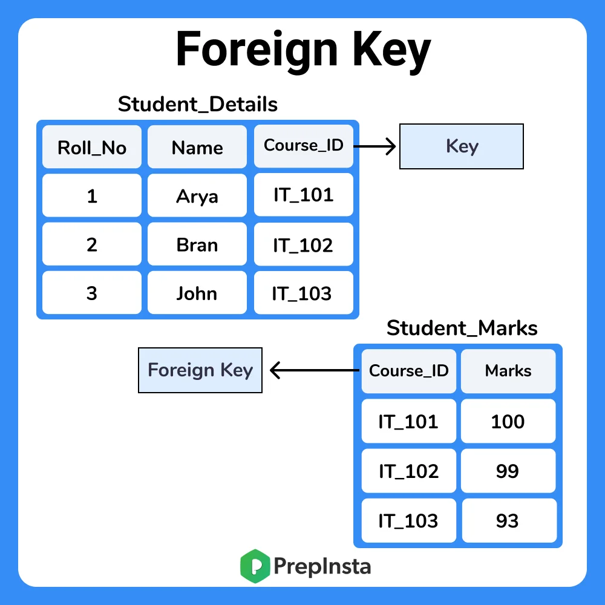
Foreign Key
Notes:
CREATE TABLE CUSTOMERS1( ID INT , NAME VARCHAR (20) , COURSE VARCHAR(10) , PRIMARY KEY (ID) );
CREATE TABLE CUSTOMERS2( ID INT , MARKS INT, REFERENCES CUSTOMERS1(ID) );

Slide 14
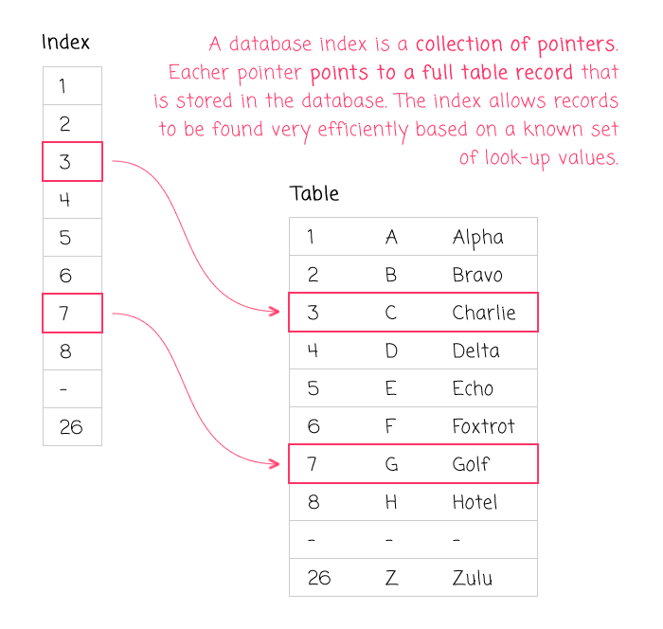
Index

Slide 15
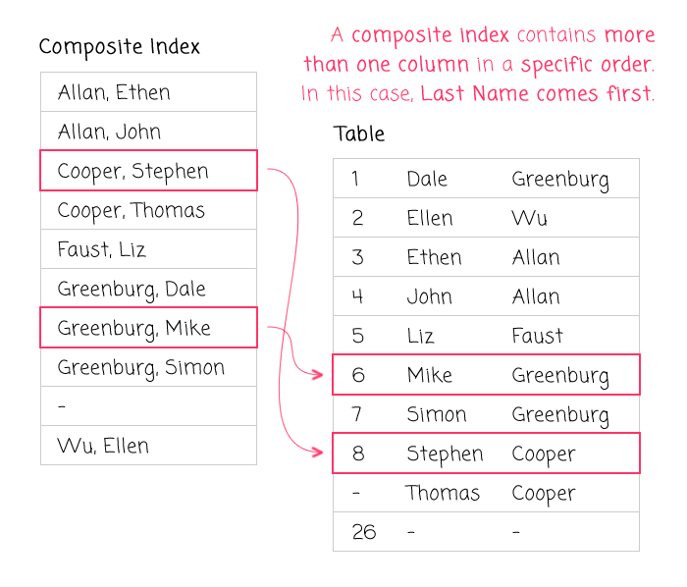
Composite Index

Slide 16
Simple Users DB

Slide 17
References
https://prepinsta.com/dbms/key-constraints/
https://www.bennadel.com/blog/3467-the-not-so-dark-art-of-designing-database-indexes-reflections-from-an-average-software-engineer.htm

